Slide 1
Managing a boot/tftp server
Version A.01
H3065S Module 14 Slides

Slide 2

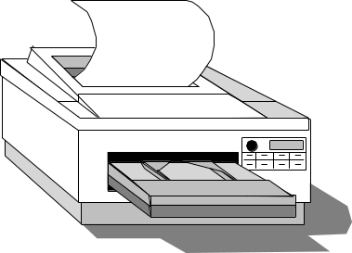
What Are bootp and tftp?
broadcast
Who am I ? Who knows how to boot me ?
bootp
IP Address, subnet mask, etc . . .
Client
Network
Printer
tftp
Configuration file
Bootp/TFTP
Server
The protocols bootp and tftp are used by:
X-terminals
network-based printers
diskless clients
others
a673154

Slide 3
Enabling bootp and tftp Services
1. Ensure services are defined in /etc/services:
# cat /etc/services
bootps 67/udp
tftp 69/udp
2. Ensure services are defined in /etc/inetd.conf:
# cat /etc/inetd.conf
tftp dgram udp wait root /usr/lbin/tftp tftp
bootps dgram udp wait root /usr/lbin/bootpd bootpd
3. Ensure tftp account is defined in /etc/passwd:
# cat /etc/passwd
tftp:*:510:1:Trivial FTP User:/home/tftpdir:/usr/bin/false
4. Reconfigure inetd daemon (if necessary):
# inetd -c
a673155

Slide 4
The /etc/bootptab File
Sample entries in the /etc/bootptab file:
# cat /etc/bootptab
myprinter:\
hn:\
ht=ether:\
ha=080009a752c3:\
ip=156.153.82.239:\
T144=“myprinter.cfg”:\
vm=rfc1048
myxterm:\
ba:\
hn:\
ht=ether:\
ha=0800091ef227:\
ip=156.153.198.155:\
bf=/opt/hpxt/enware/xthome/:\
T144=“myxterm.cfg”:\
vm=rfc1048
a673156

Slide 5

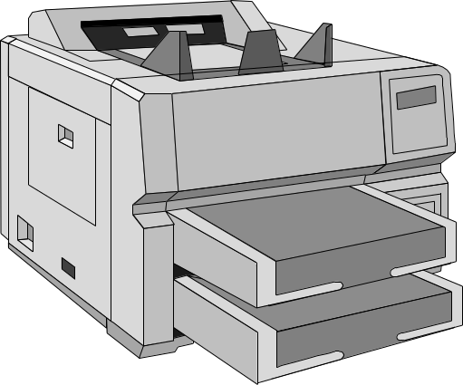
Booting Network Printers
1
2
bootp
3
tftp
4
1. Printer powered up; broadcasts request.
2. Server responds with IP address, netmask, and so on.
3. Server downloads configuration file.
4. Printer is ready.
a673157

Slide 6
Configuring a Network Printer Server
Step-by-step procedure for configuring a network printer server:
1. Install HPNP product.
2. Enable bootp/tftp in /etc/services.
3. Enable bootp/tftp in /etc/inetd.conf.
4. Add the host name to DNS or /etc/hosts.
5. Add bootptab entry using jetadmin.
a673158

Slide 7
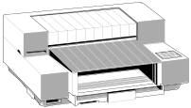
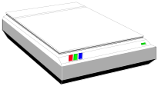
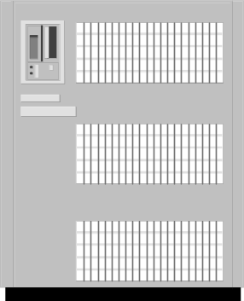
What Is an X-Station?
A
D
B
E
Printer
C
F
Scanner
X - Station
X - Station
G
H
I
Server
a673159

Slide 8
Booting an X-Station
4
1
XDMCP
2
bootp
3
tftp
1. X-Station powered on; broadcasts request.
2. Server responds with IP address, netmask, and so on.
3. Server downloads X software, fonts, and other files.
4. X-Station requests login service from a session server.
X - Station
a673160

Slide 9
Configuring an X-Terminal Server
Step-by-step procedure for configuring an X-Terminal server:
1. Install the ENWARE product.
2. Enable bootp/tftp in /etc/services.
3. Enable bootp/tftp in /etc/inetd.conf.
4. Add the host name to DNS or /etc/hosts.
5. (optional) NFS export /opt/hpxt.
6. Add bootptab entry using xtadm.
7. Select a session server.
8. Enable CDE on session server.
a673161

